Slide 1





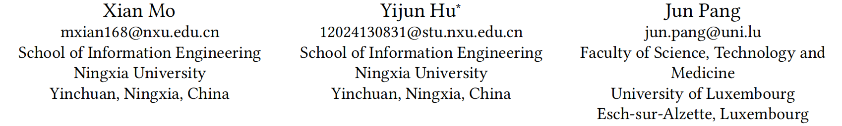





ATAI
Advanced Techniqueof Artificial Intelligence
ATAI
ChongqingUniversity _{AdvancedTechniqueof}
of Technology Artificial Intelligence
Chongqing University of
Technology
Chongqing University ^{ATAI}
_{of Technology} Advanced Techniqueof
Artificial Intelligence
Chongqing University of Technology
Chongqing University of Technology
Large Language Models-Enhanced Semantic Diffusion for User-Centric Recommendation
Code: https://github.com/HCoder-PY/SEDIRec_WWW2026.
2026.6.28
—— WWW_2026
Reported by Yang Hu
1

Slide 2

ATAI
AdvancedTechniqueof
Artificial Intelligence
ATAI
ChongqingUniversity _{AdvancedTechniqueof}
of Technology Artificial Intelligence
ChongqingUniversity of Technology
Motivation
1.Structural user-side knowledge is difficult to construct and integrate due to inherent scarcity and improper granularity
2.Content (e.g., user-side knowledge) generated by LLMs may include unintended noise due to the hallucination issue，and the effective transfer of natural language from the user-side knowledge domain to the recommendation domain remains underexplored

Slide 3

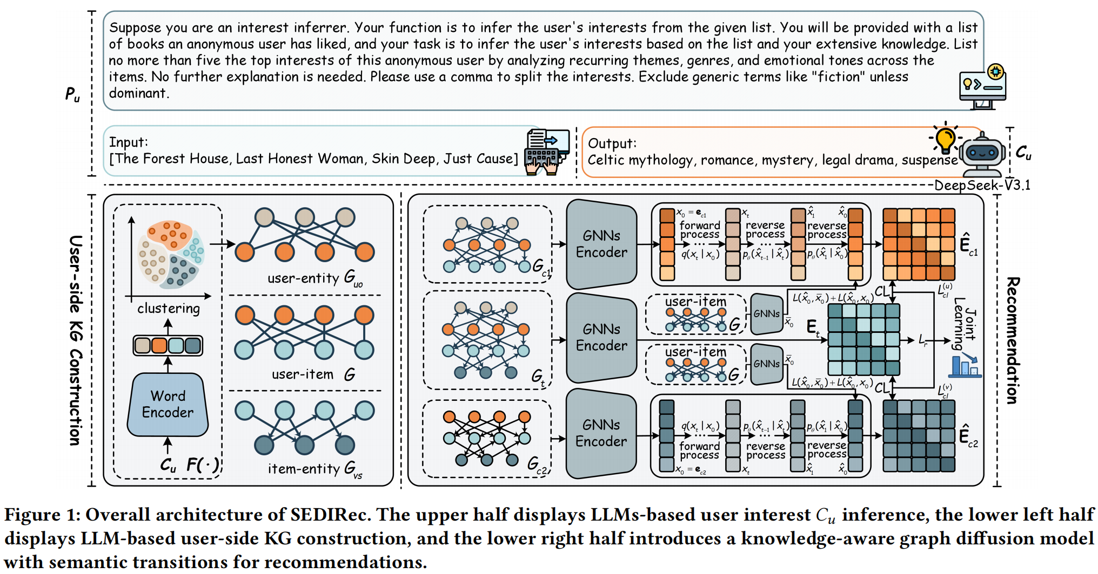
ChongqingUniversity of Technology
ATAI
AdvancedTechniqueof
Artificial Intelligence
ATAI
ChongqingUniversity _{AdvancedTechniqueof}
of Technology Artificial Intelligence
Overview

Slide 4

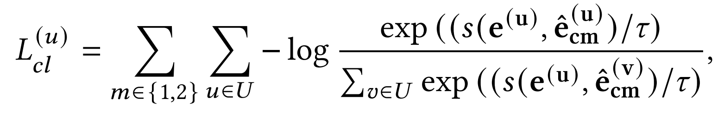
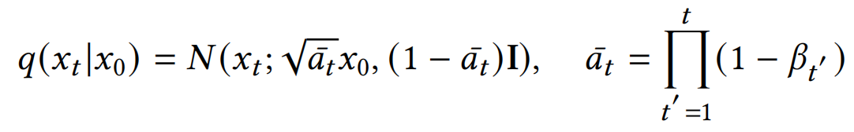
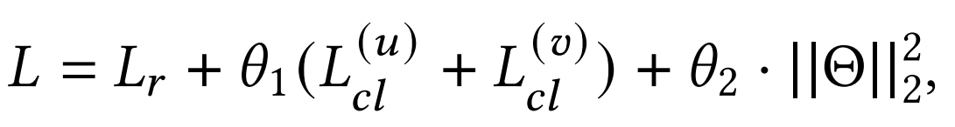
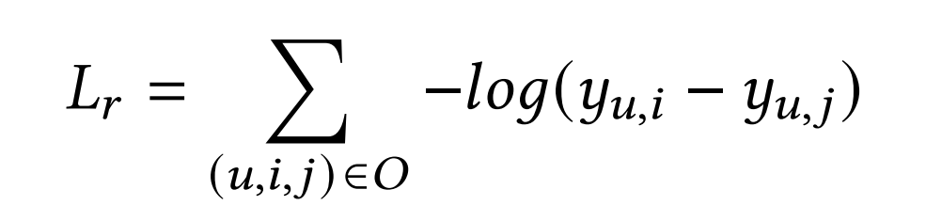
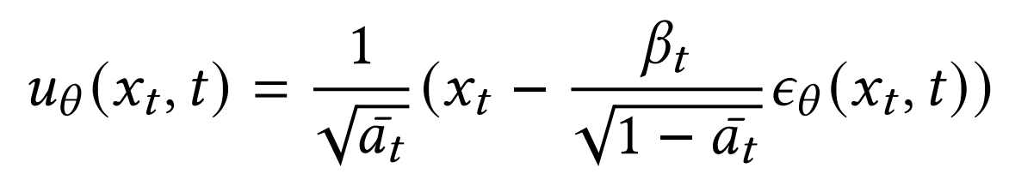
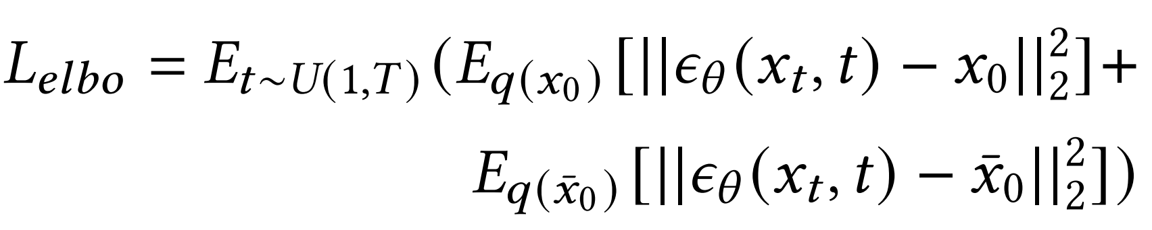
ChongqingUniversity of Technology
ATAI
AdvancedTechniqueof
Artificial Intelligence
ATAI
ChongqingUniversity _{AdvancedTechniqueof}
of Technology Artificial Intelligence
Method
(1)
(2)
(7)
(3)
(8)
(4)
(9)
(5)
(6)

Slide 5

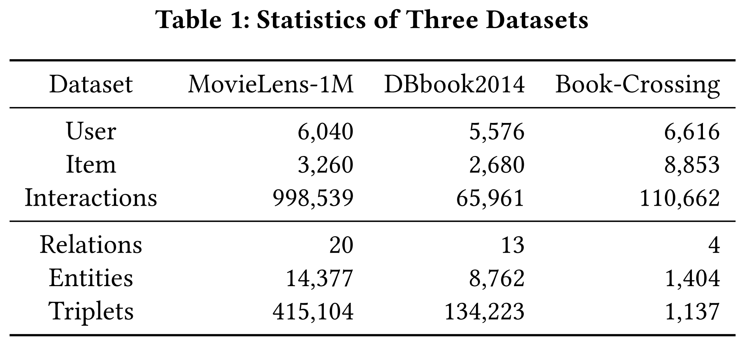
ATAI
AdvancedTechniqueof
Artificial Intelligence
ATAI
ChongqingUniversity _{AdvancedTechniqueof}
of Technology Artificial Intelligence
ChongqingUniversity of Technology
Experiments

Slide 6
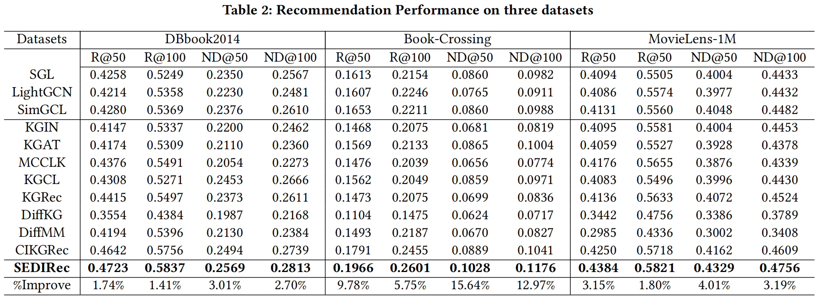
ATAI
AdvancedTechniqueof
Artificial Intelligence
ATAI
ChongqingUniversity _{AdvancedTechniqueof}
of Technology Artificial Intelligence
ChongqingUniversity of Technology
Experiments

Slide 7
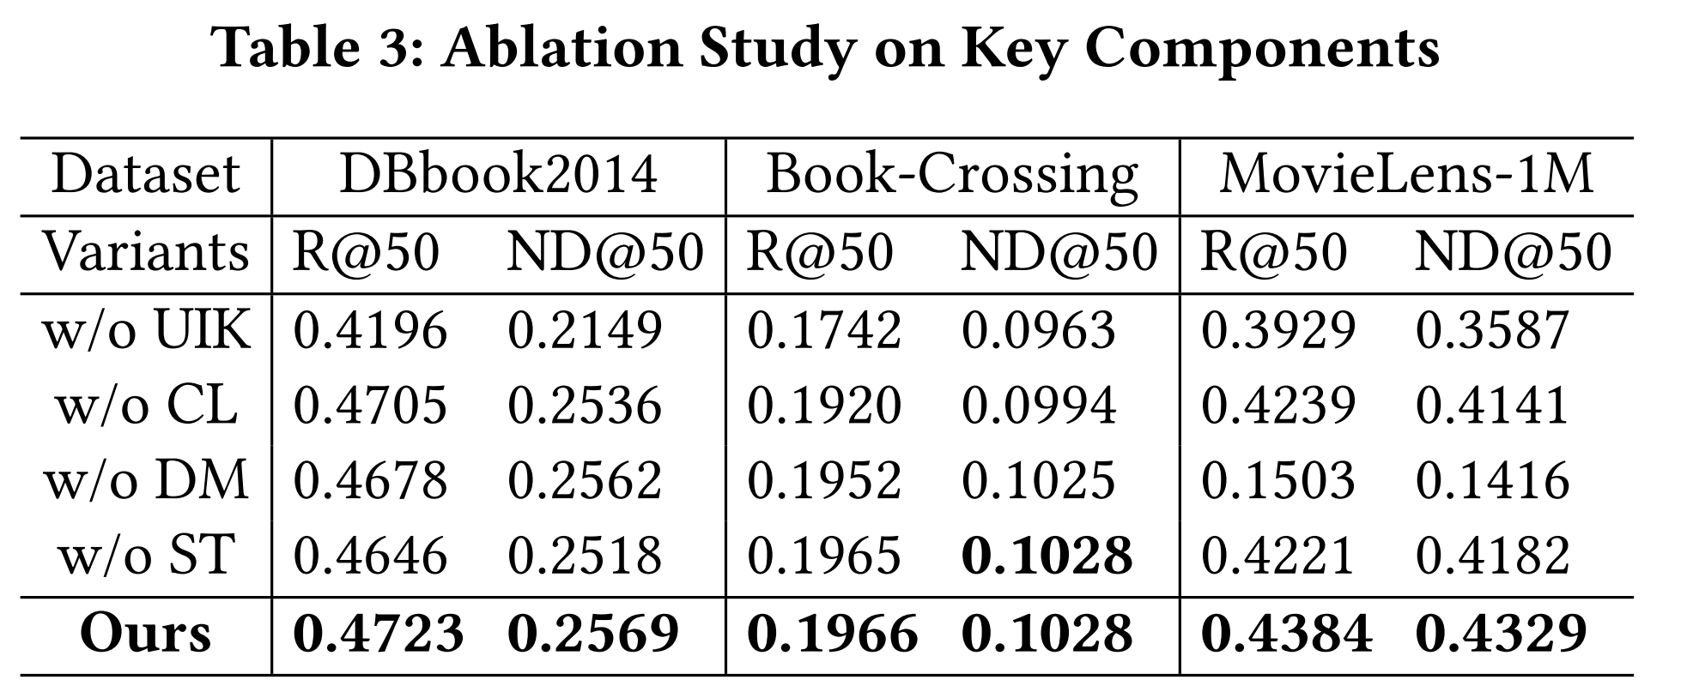
ATAI
AdvancedTechniqueof
Artificial Intelligence
ATAI
ChongqingUniversity _{AdvancedTechniqueof}
of Technology Artificial Intelligence
ChongqingUniversity of Technology
Experiments

Slide 8
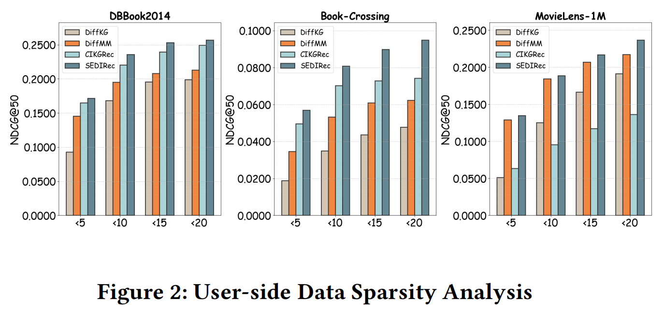
ATAI
AdvancedTechniqueof
Artificial Intelligence
ATAI
ChongqingUniversity _{AdvancedTechniqueof}
of Technology Artificial Intelligence
ChongqingUniversity of Technology
Experiments

Slide 9
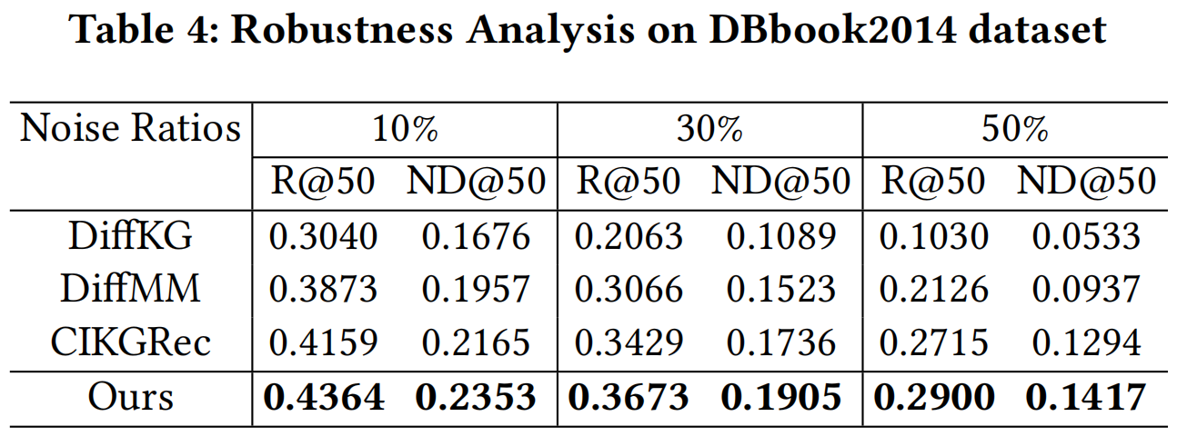
ATAI
AdvancedTechniqueof
Artificial Intelligence
ATAI
ChongqingUniversity _{AdvancedTechniqueof}
of Technology Artificial Intelligence
ChongqingUniversity of Technology
Experiments

Slide 10
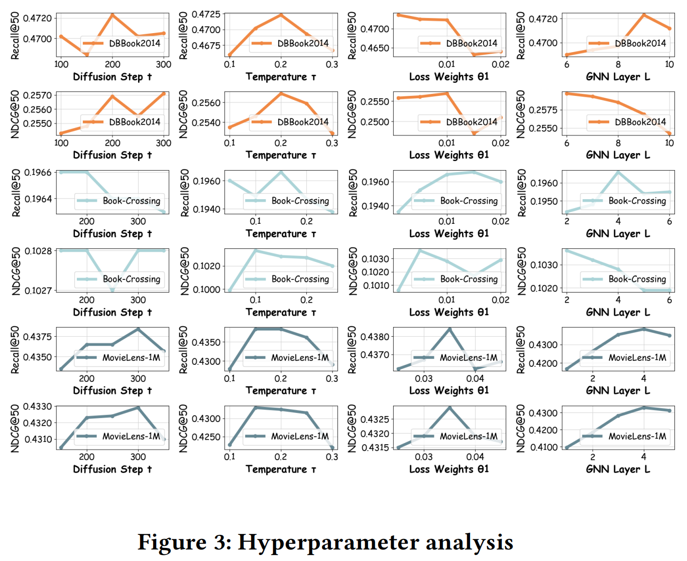
ATAI
AdvancedTechniqueof
Artificial Intelligence
ATAI
ChongqingUniversity _{AdvancedTechniqueof}
of Technology Artificial Intelligence
ChongqingUniversity of Technology
Experiments

Slide 11
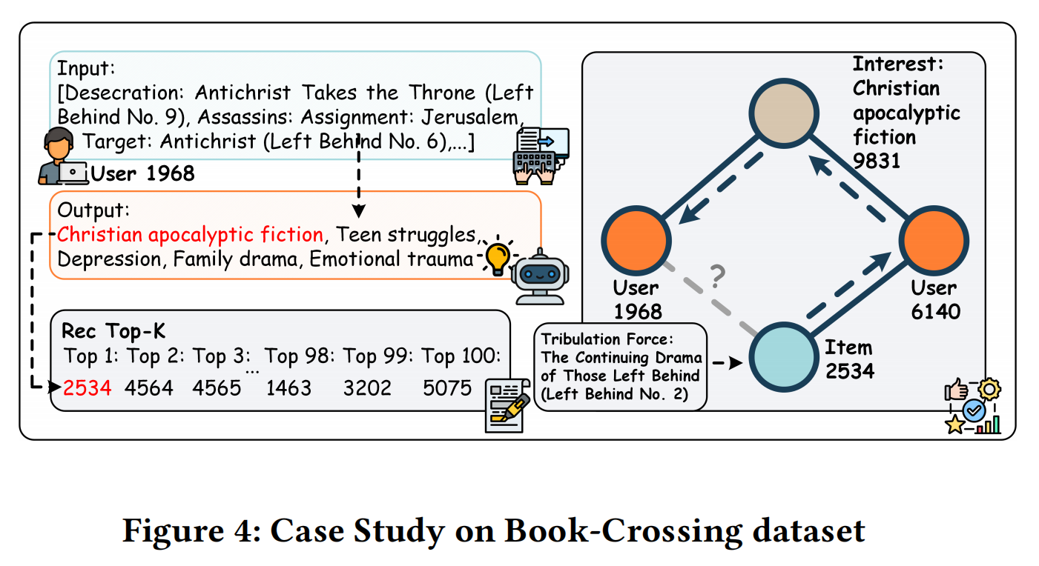
ATAI
AdvancedTechniqueof
Artificial Intelligence
ATAI
ChongqingUniversity _{AdvancedTechniqueof}
of Technology Artificial Intelligence
ChongqingUniversity of Technology
Experiments

Slide 12


ChongqingUniversity of Technology
ATAI
AdvancedTechniqueof
Artificial Intelligence
ATAI
ChongqingUniversity _{AdvancedTechniqueof}
of Technology Artificial Intelligence
Thanks!

